Slide 1
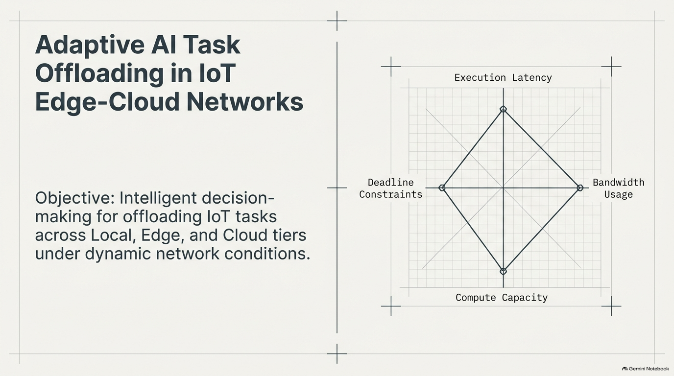

Slide 2
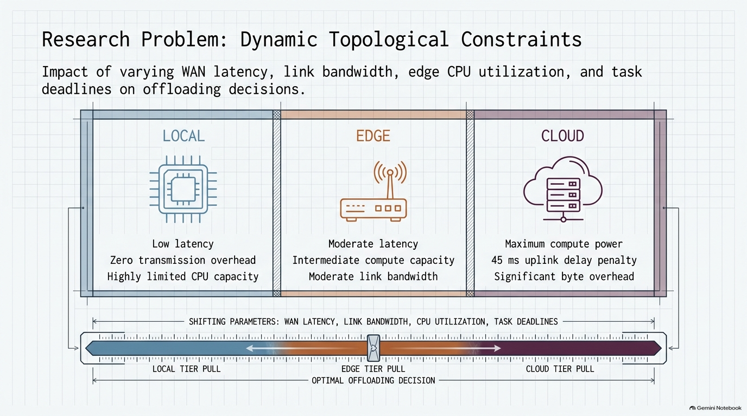

Slide 3
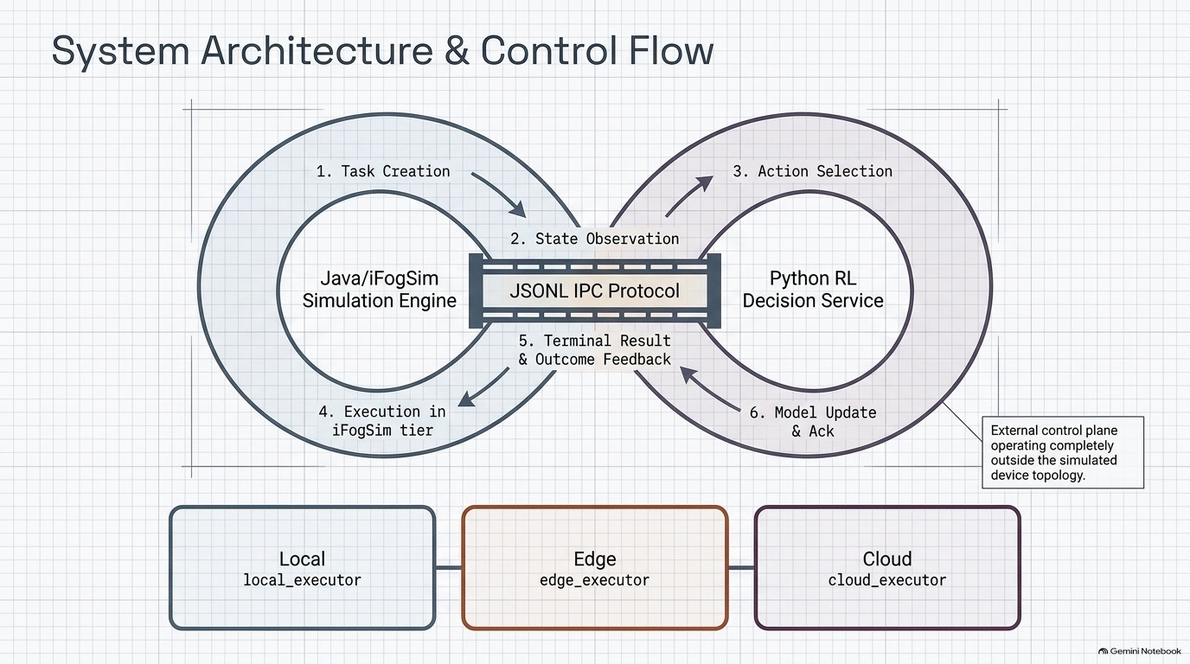

Slide 4
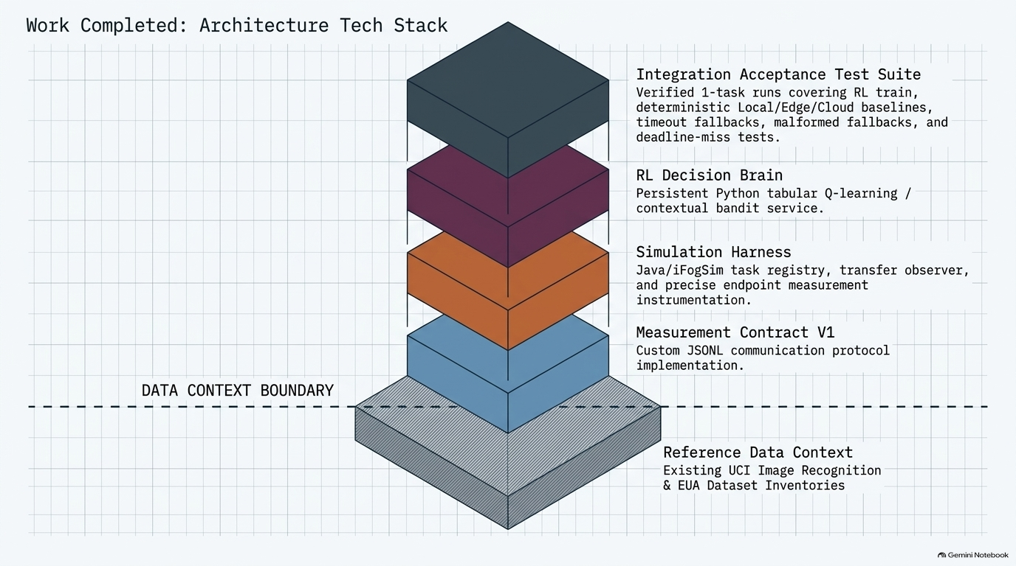

Slide 5
ADAPTIVE AI TASK OFFLOADING RESEARCH
Model Architecture: Closed-Loop Python-Java RL Pipeline
Inter-Process Communication (IPC): Java/iFogSim simulation engine connects synchronously to the Python decision service via line-delimited JSON (JSONL protocol) for telemetry observations, action dispatch, and outcome feedback.
7-STAGE CLOSED-LOOP CONTROL FLOW
1. Observation
2. Discretization
3. Q-Table Lookup
4. Action Selection
iFogSim captures:
• Task size (MI)
• WAN latency
• Edge CPU util.
• Deadline constraint
Maps telemetry to
discrete state index
(1 of 54 states)
Evaluates Q-value matrix
(54 states × 3 actions)
for current state
Selects decision:
• 0 = Local
• 1 = Edge
• 2 = Cloud
7. Q-Table Update
6. Reward Feedback
5. iFogSim Execution
Updates Q(s,a) entry
and returns ACK to
simulation engine
Dispatches workload to
selected tier & records
execution telemetry
Calculates reward scalar R
based on latency, deadline,
and resource cost
Notes:
Slide 1 Speaker Notes:
- This slide illustrates the closed-loop architecture between Java iFogSim and the Python agent via JSONL IPC.
- The control loop begins when iFogSim generates a task and transmits telemetry (task size, WAN latency, edge utilization, deadline).
- Python discretizes the observation into one of 54 states, performs a Q-table lookup, selects an offloading action (0=Local, 1=Edge, 2=Cloud), and sends it back.
- iFogSim executes the task at the designated tier, records latency and bandwidth feedback, and sends terminal outcome back to update the Q-table.

Slide 6
ADAPTIVE AI TASK OFFLOADING RESEARCH
Decision Space & Reward Formulation: Contextual Bandit Model
State Space & Input Features (54 Discrete States)
• 4 Telemetry Features: Task Size (MI), WAN Latency (ms), Edge CPU Utilization (%), and Task Deadline (ms).
• State Discretization: Feature values are binned into discrete ranges to map continuous simulator telemetry into exactly 54 state buckets.
• Q-Table Dimensions: 54 states × 3 actions (162 total Q-value entries).
Reward Formulation Equation
R = − (1.0 × Latency_norm + 2.0 × Deadline_Miss + 0.5 × Resource_Cost)
• Objective: Maximizing scalar reward R minimizes execution latency, penalizes deadline misses heavily (2.0 weight), and conserves resource usage.
Action Space (3 Execution Tiers)
• Action 0 — Local Execution: Zero transmission overhead, immediate execution, limited CPU capacity.
• Action 1 — Edge Computing: Moderate network latency & bandwidth overhead, intermediate compute capacity.
• Action 2 — Cloud Infrastructure: High compute capacity, higher network WAN latency (45 ms uplink) & byte overhead.
Execution Modes (Training vs. Evaluation)
• Training Mode: Uses ε-greedy action selection for exploration with online Q-table updates.
• Evaluation Mode: Uses greedy action selection (argmax Q) with learning disabled (frozen table).
Notes:
Slide 2 Speaker Notes:
- The model operates on 4 telemetry features binned into 54 discrete states and controls 3 actions: Local (0), Edge (1), and Cloud (2).
- The reward function combines normalized latency, a heavy deadline miss penalty (weight 2.0), and resource cost.
- In training mode, action selection follows an epsilon-greedy strategy. In evaluation mode, it is strictly greedy with updates frozen.
- Crucially, the current configuration sets discount factor gamma=0, making this a contextual bandit rather than sequential Q-learning. The current checkpoint is a functional integration test, not a fully trained baseline-beating model.

Slide 7
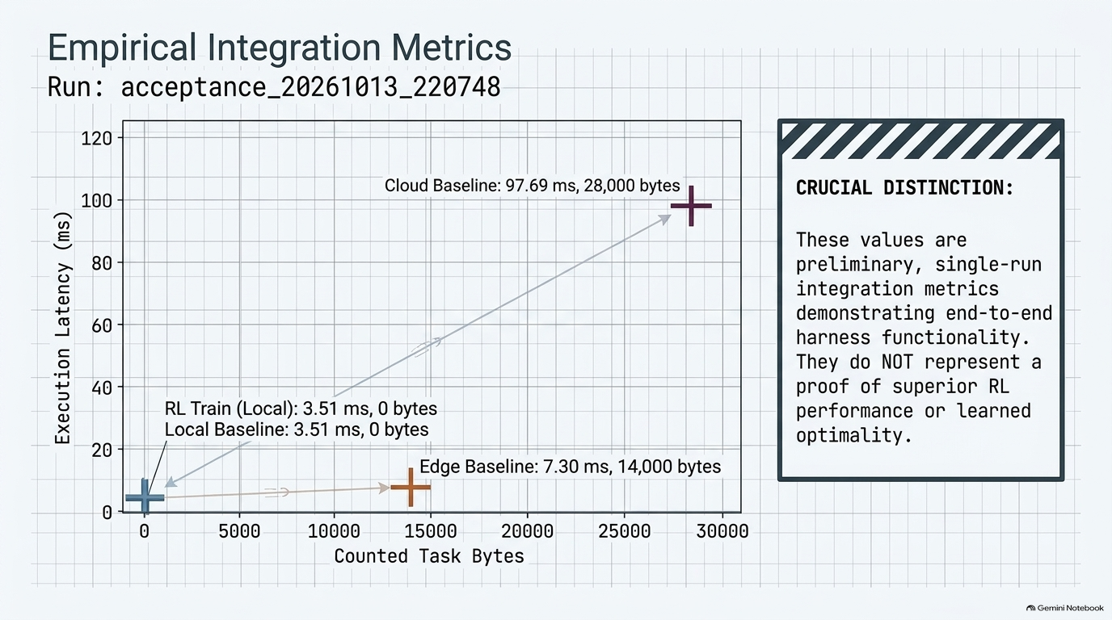

Slide 8
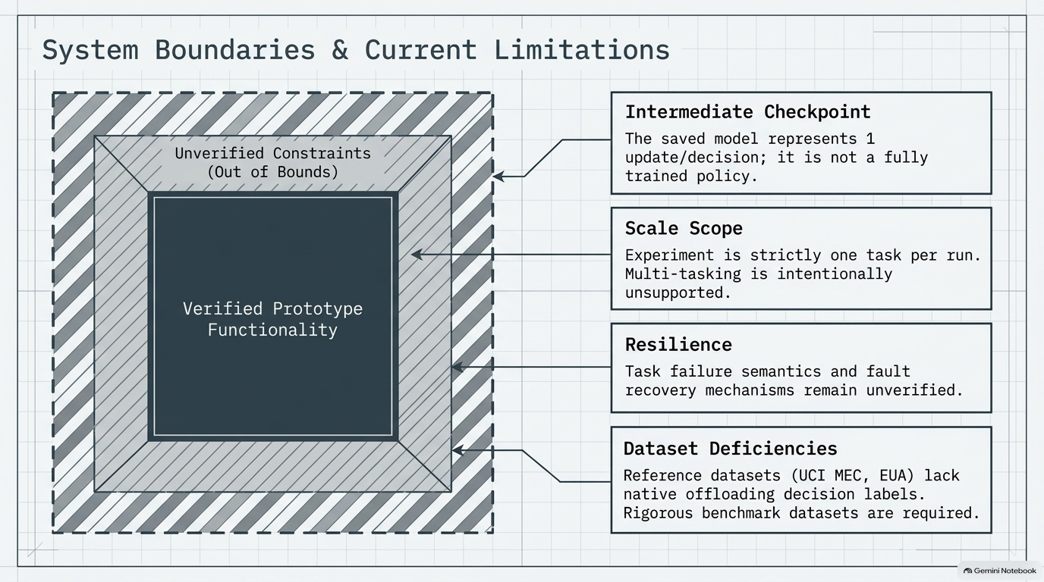

Slide 9


